Slide 1
Digital Learning platform
SQL Exercises

Slide 2


1. EXERCISES
The list of courses with the highest total number of excellent and good students
Statistics of courses: How many students are excellent, good, and weak.
List of subjects taught by female OOP instructors with the highest average scores.
The list of teachers who have never taught OOP.
Statistic of total students registered by month, week, year.
List the students who pass, average, and fail by month.

Slide 3
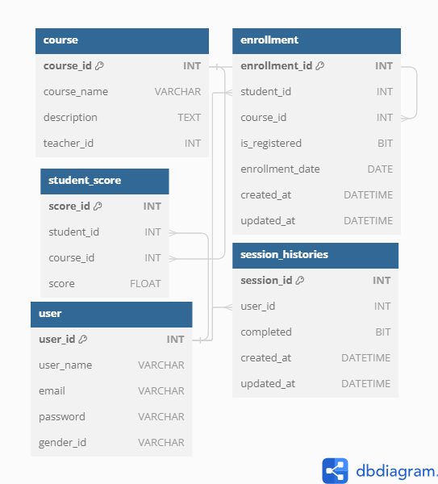
Database Diagram

Slide 4
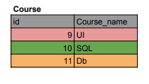
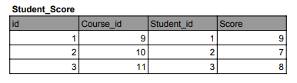
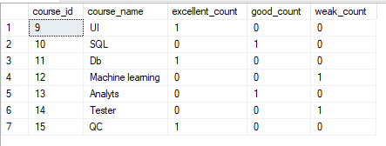
Query
The list of courses with the highest total number of excellent and good students
SELECT
c.course_id,
c.course_name,
SUM(CASE WHEN ss.score >= 8 THEN 1 ELSE 0 END) AS excellent_count,
SUM(CASE WHEN ss.score >= 6 AND ss.score < 8 THEN 1 ELSE 0 END) AS good count,
SUM(CASE WHEN ss.score < 6 THEN 1 ELSE 0 END) AS weak_count
FROM
course c
LEFT JOIN
student_score ss ON c.course_id = ss.course_id
GROUP BY
c.course_id, c.course_name;
Result

Slide 5
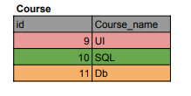
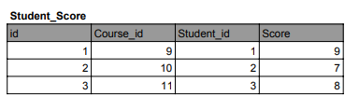
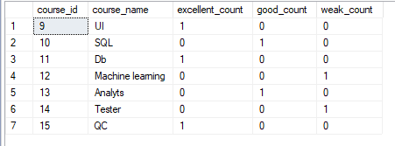
Query
Statistics of courses: How many students are excellent, good, and weak.
SELECT
c.course_id,
c.course_name,
SUM(CASE WHEN ss.score >= 8 THEN 1 ELSE 0 END) AS excellent_count,
SUM(CASE WHEN ss.score >= 6 AND ss.score < 8 THEN 1 ELSE 0 END) AS good count,
SUM(CASE WHEN ss.score < 6 THEN 1 ELSE 0 END) AS weak_count
FROM
course c
LEFT JOIN
student_score ss ON c.course_id = ss.course_id
GROUP BY
c.course_id, c.course_name;
Result

Slide 6

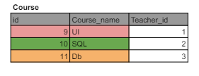
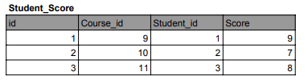

Query
List of subjects taught by female OOP instructors with the highest average scores.
SELECT
c.course_id,
c.course_name,
AVG(ss.score) AS average_score
FROM
course AS c
JOIN
[user] AS u ON c.teacher_id = u.user_id
JOIN
student_score AS ss ON c.course_id = ss.course_id
WHERE
u.[gender] = 'Female'
AND c.course_name = 'OOP'
GROUP BY
c.course_id, c.course_name
ORDER BY
average _score DESC;
Result

Slide 7
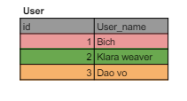
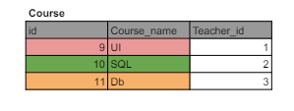
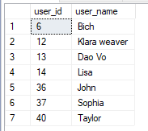
Query
The list of teachers who have never taught OOP.
SELECT DISTINCT
u.user_id,
u.user_name
FROM
[user] AS u
LEFT JOIN
course AS c ON u.user_id = c.teacher_id
WHERE
u.user_id NOT IN (
SELECT DISTINCT
c.teacher_id
FROM
course AS c
WHERE
c.course_name = 'OOP';
Result

Slide 8
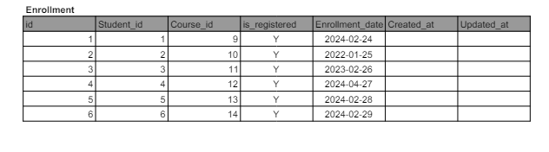
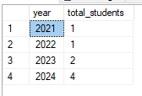
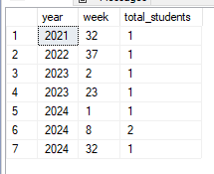
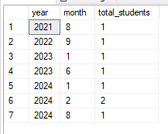
Statistic of total students registered by month, week, year.
Calculate the total number of students registered per year
SELECT
YEAR(enrollment_date) AS year,
COUNT(*) AS total_students
FROM
enrollment
GROUP BY
YEAR(enrollment_date)
ORDER BY
year;
Result
Calculate the total number of students registered per month
SELECT
YEAR(enrollment_date) AS year,
MONTH(enrollment_date) AS month,
COUNT(*) AS total_student
FROM
enrollment
GROUP BY
YEAR(enrollment_date),
MONTH(enrollment_date)
ORDER BY year, month;
Calculate the total number of students registered per week
Result
Result
SELECT
YEAR(enrollment_date) AS year,
DATEPART(WEEK, enrollment_date)
AS week,
COUNT(*) AS total_students
FROM
enrollment
GROUP BY
YEAR(enrollment_date),
DATEPART(WEEK, enrollment_date)
ORDER BY year, week;

Slide 9
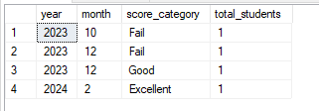
SELECT
YEAR(s.created_at) AS year,
MONTH(s.created_at) AS month,
CASE
WHEN s.score >= 8 THEN 'Excellent'
WHEN s.score >= 5 AND s.score < 8 THEN 'Good'
ELSE 'Fail'
END AS score_category,
COUNT(*) AS total_students
FROM
student_score s
JOIN
[user] u ON s.student_id = u.user_id
GROUP BY
YEAR(s.created_at),
MONTH(s.created_at),
CASE
WHEN s.score >= 8 THEN 'Excellent'
WHEN s.score >= 5 AND s.score < 8 THEN 'Good'
ELSE 'Fail'
END
ORDER BY
year, month, score_category;
Query
List the students who pass, average, and fail by month.
Result

Slide 10
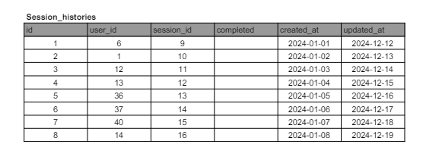
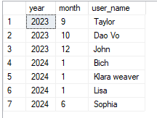
Query
SELECT DISTINCT
YEAR(sh.created_at) AS year,
MONTH(sh.created_at) AS month,
u.user_name
FROM
Session_histories sh
JOIN
[user] u ON sh.user_id = u.user_id
ORDER BY
year, month;
The list of active students by month
Result

Slide 11

THANK YOU

